Slide 1
Setting Up A Software Development Environment
Ryan M. Richard
Ames National Laboratory and Iowa State University

Slide 2
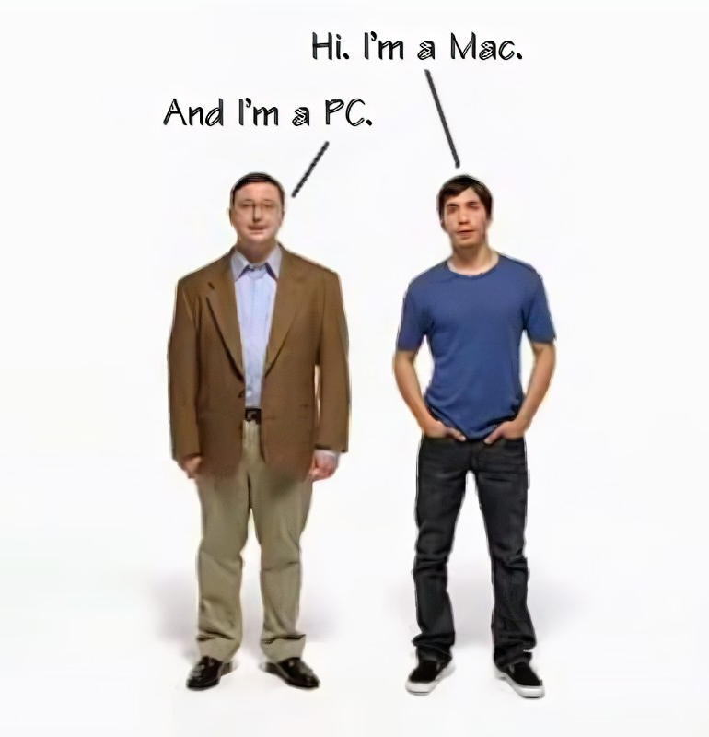
Assumptions
Have access to a computer.
The computer is running MacOS (preferred) or Windows (I’ll begrudgingly accept).
Can install software on that computer.
Current programming level is: “Terminal, that’s where I board a plane, right?”
If you’re more experienced than this, the assumption is you’ll let me oversimplify many many things.

Slide 3
Objectives
Know what a Linux terminal is.
Know how to access a Linux terminal.
Know the most important Linux terminal commands.
Install Python.
Write a “Hello World” Python module.
Run the “Hello World” Python module.

Slide 4
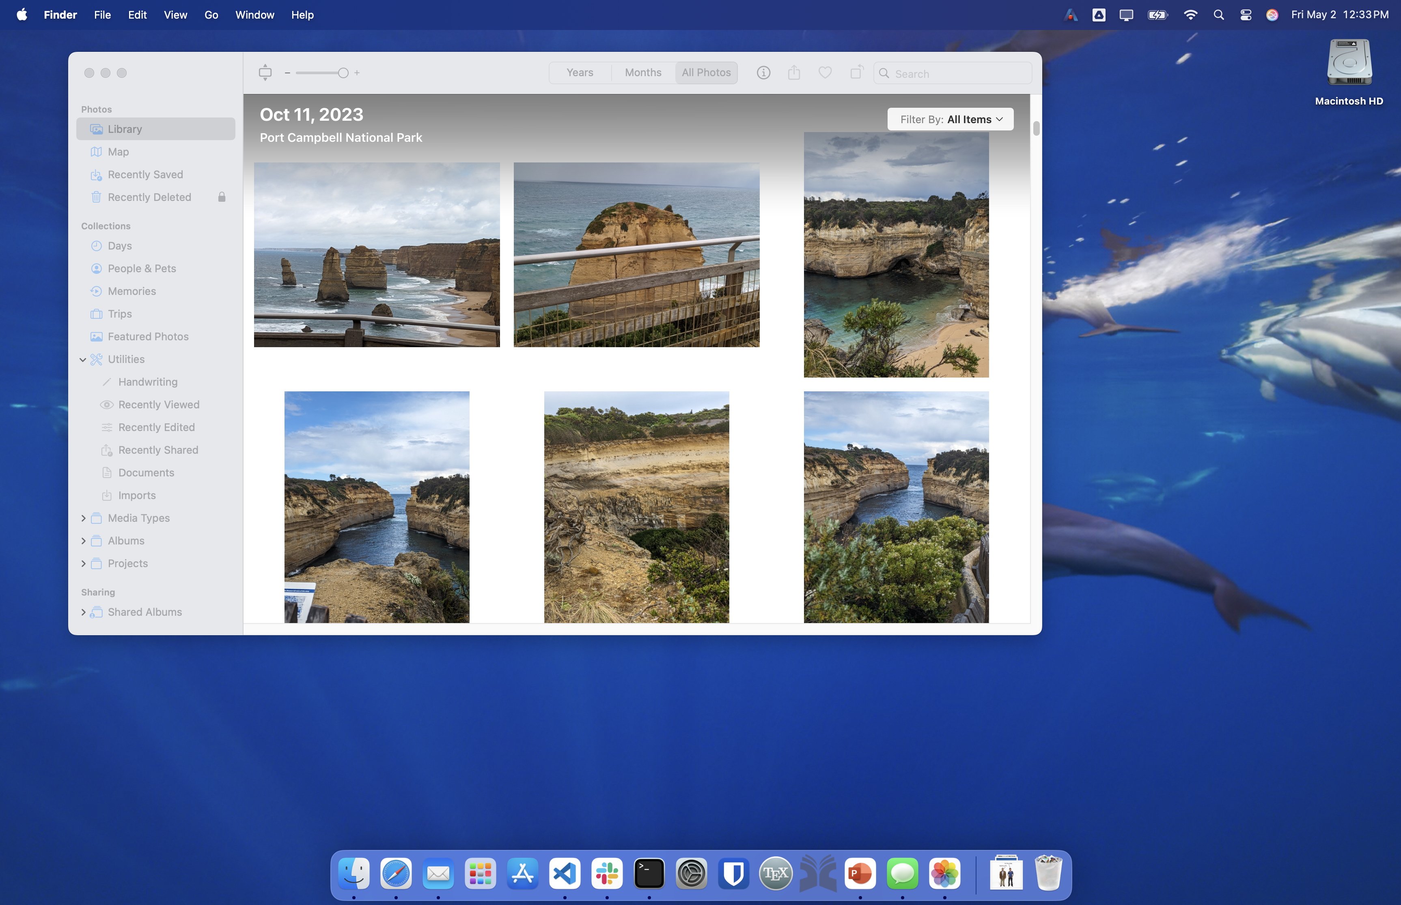
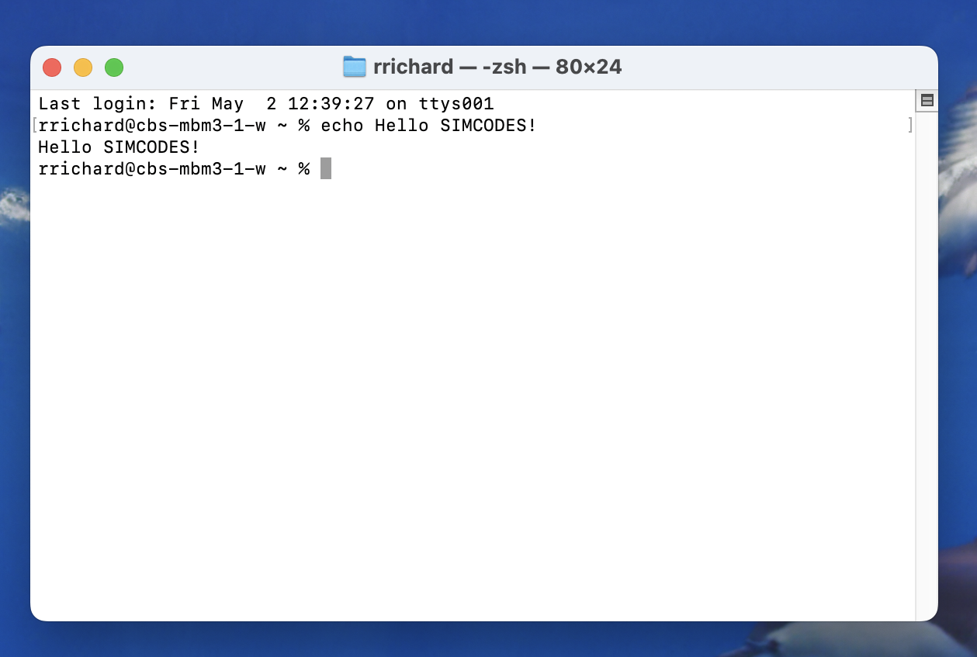
What is a Terminal?
Most people interact with their computer graphically.
Called a “Graphical User Interface” or GUI for short (pronounced gooey).
Graphics in the GUI represent pieces of the program.
Use mouse to select pieces of the graphics.
Typing is reserved for entering text/numerical data.
Can also interact with a computer through text.
Use a program called a “terminal” to do this.

Slide 5

What is Linux?
Linux is an operating system (OS) alternative to MacOS and Windows.
(Pause for diehard Linux people to correct me…)
Unlike MacOS/Windows, Linux is open source.
“Open source” means that the source code is publicly available.
Easier for people to add features.
Programmer’s preference.
Virtually every programming language is supported.
Uses little resources.
Runs on most hardware.
Community supported.

Slide 6
What is a Linux Terminal?
Strictly speaking, it’s a terminal you can use to interact with the Linux OS.
More loosely, it’s a terminal that supports Linux commands.
Contrast this with Window’s PowerShell (if you know about it).
TL;DR.
“Linux” = best OS (according to programmers).
“Terminal” = way to interact with your computer via text.
“Linux Terminal” = is the best way to interact with your computer via text (according to programmers).
Disclaimer: From here forward we assume Linux terminals, i.e., if you try the commands in PowerShell or another terminal they may not work.

Slide 7
Why Do I Want To Use a Terminal?
Because I said so… (just kidding)
Automation!!!
Great for tutorials.
Easy: git clone https://github.com/SIMCODES-ISU/.github
Hard: “Open a web browser. Navigate to GitHub. Up by the cat-thing, type in the search bar…”.
Usually how you interact with remote computers.
Sending/receiving graphics requires sending a lot of extra data.

Slide 8
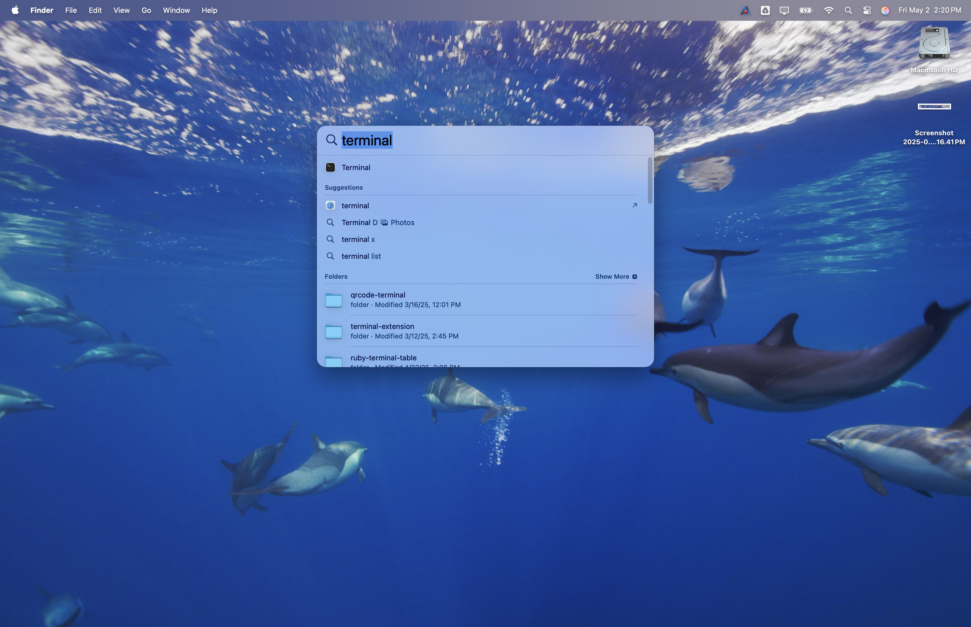
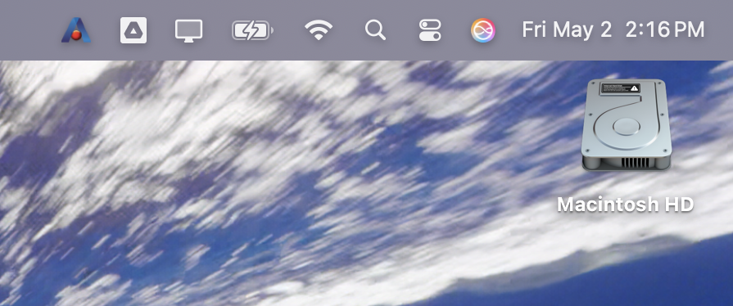
Accessing a Linux Terminal (MacOS): Part 1
Open spotlight (magnifying glass)
1
Type “terminal”
2
Click on terminal
3

Slide 9
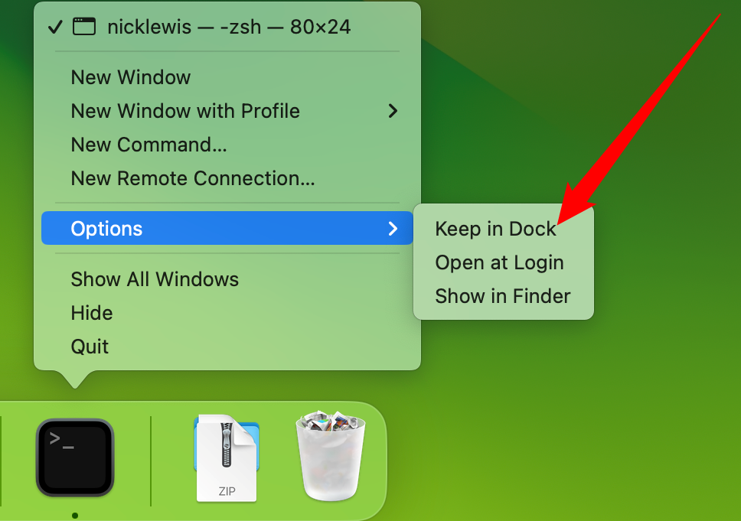
Accessing a Linux Terminal (MacOS): Part 2
Please wait for your Windows colleagues (it’s going to be a while).
In the meantime, consider pinning terminal to your dock.

Slide 10
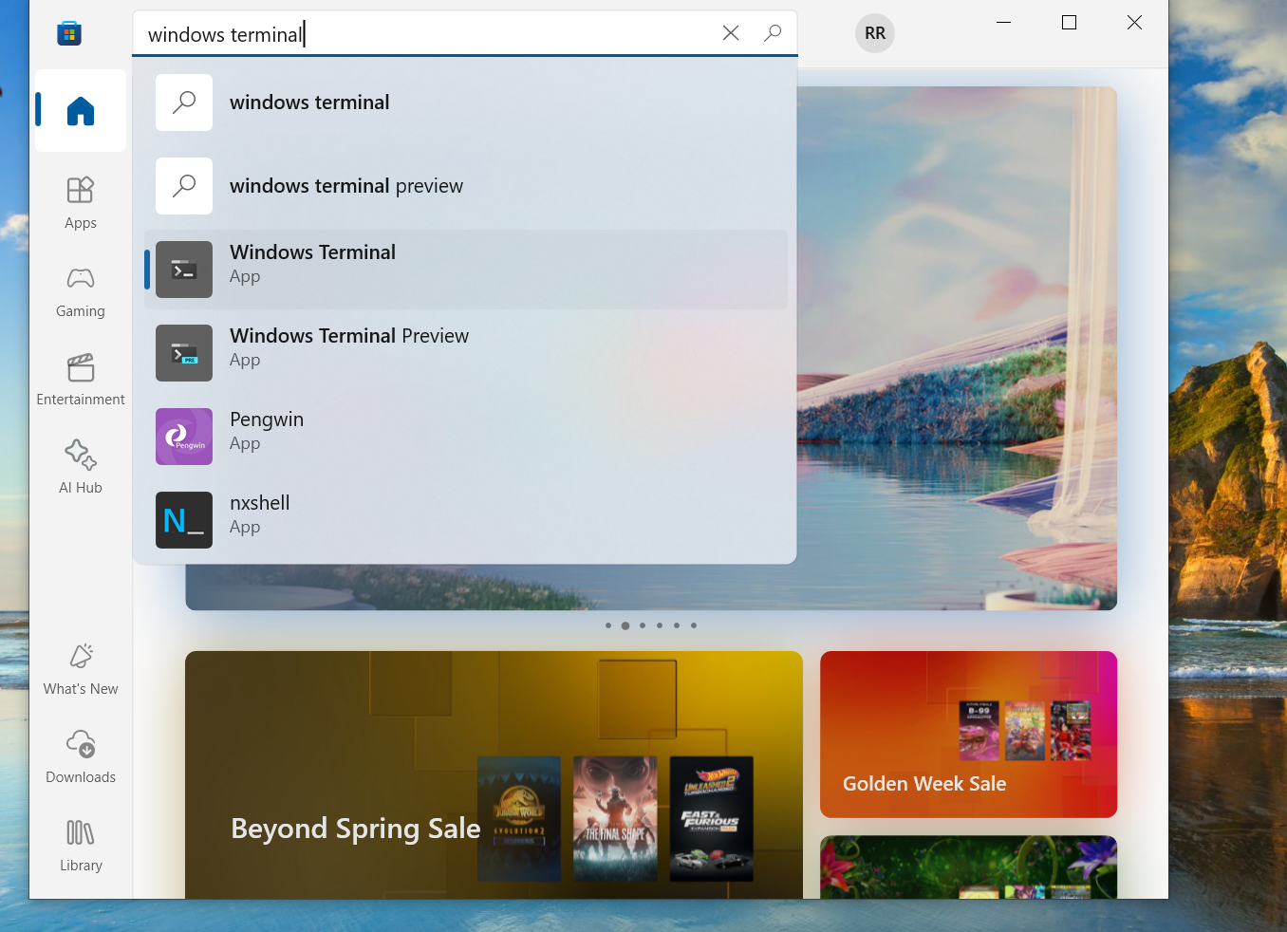
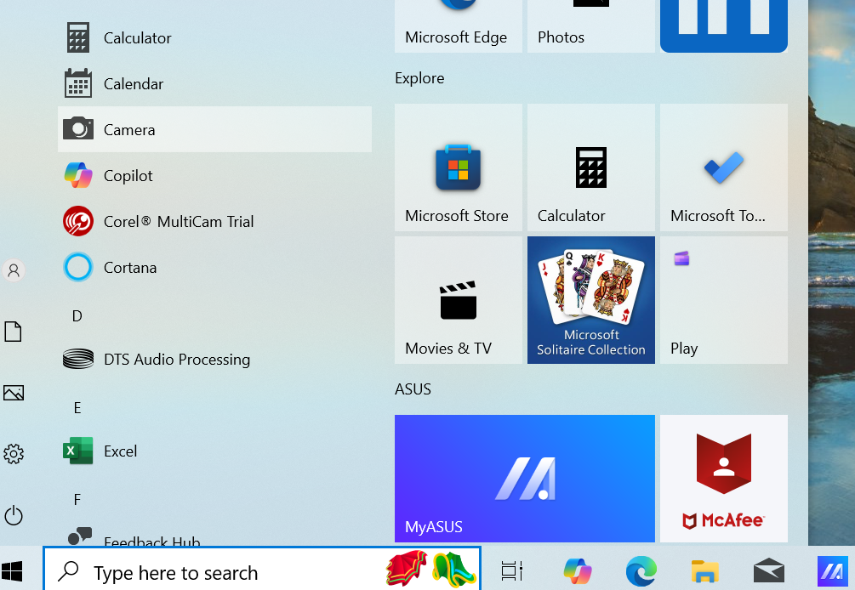
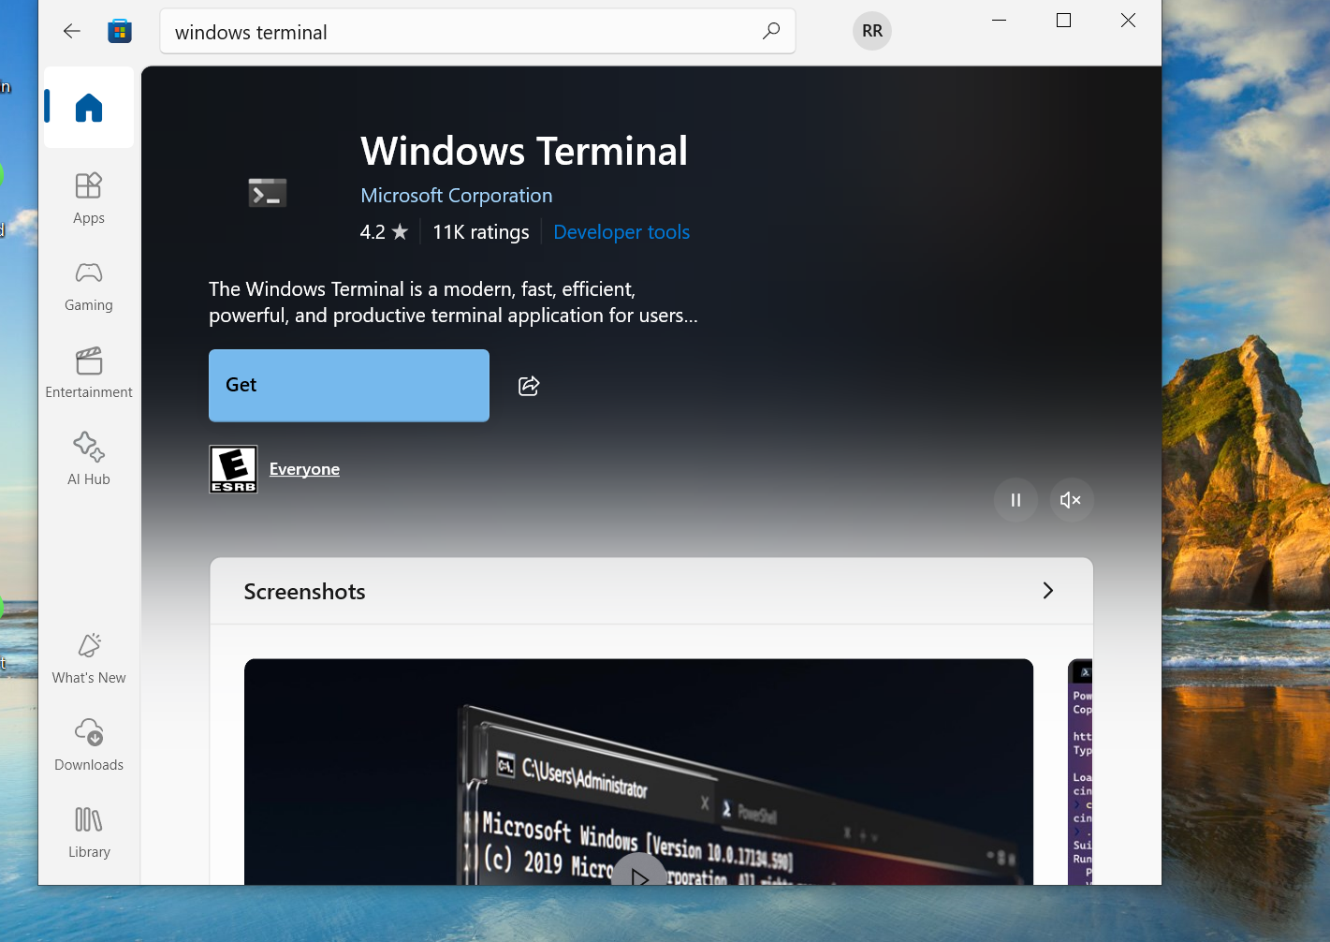
Accessing a Linux Terminal (Windows <11): Part 1
Go to Microsoft Store.
1
Search “Windows Terminal”.
2
Click “Get”.
3

Slide 11
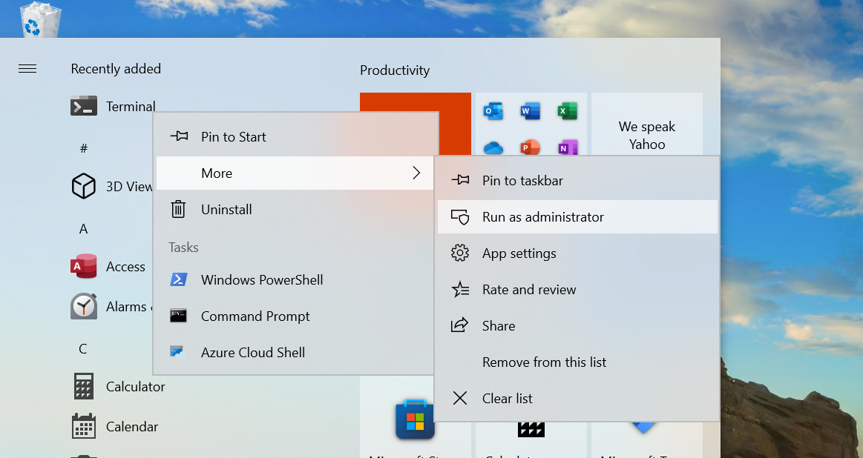
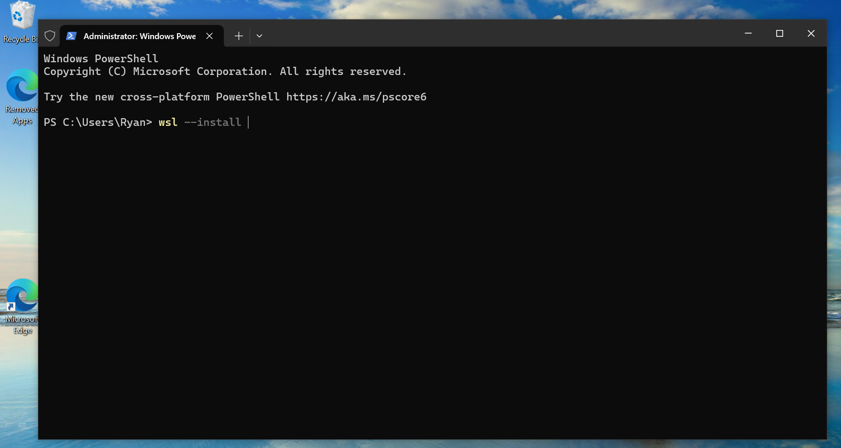
Accessing a Linux Terminal (Windows): Part 2
Open start. Search for “Terminal.” Right click “Terminal”.
1
Choose “More” -> “Run as administrator”.
2
Type wsl --install
3
4
5
6

Slide 12
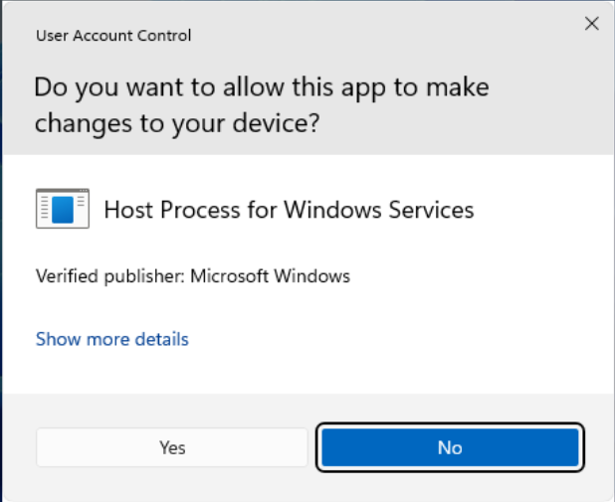
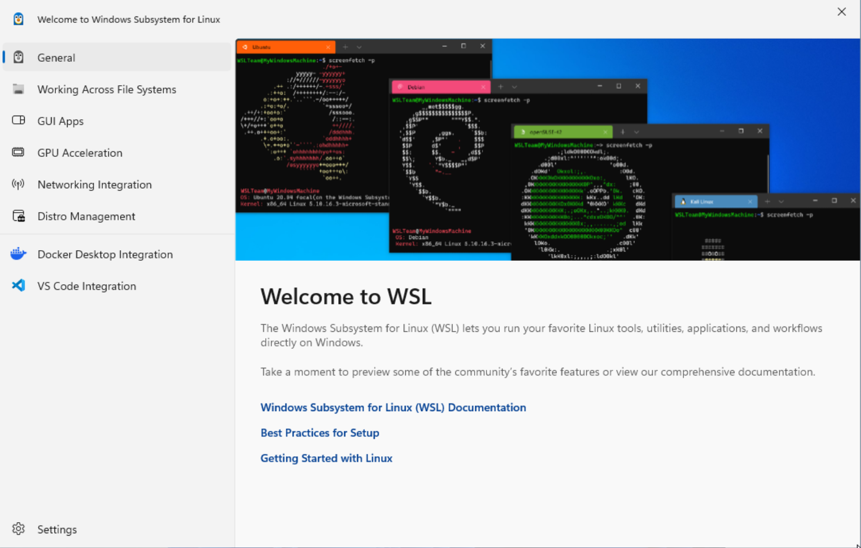
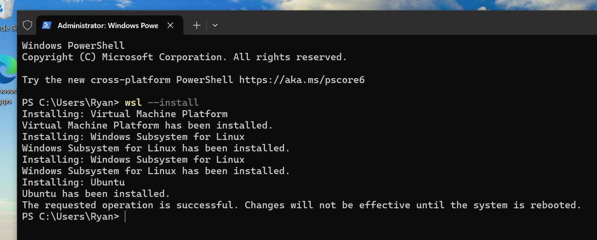
Accessing a Linux Terminal (Windows): Part 3
If it asks for permission, grant it.
1
After install, reboot.
2
If you get a “Welcome to WSL” window, close it.
3
7
8
9

Slide 13
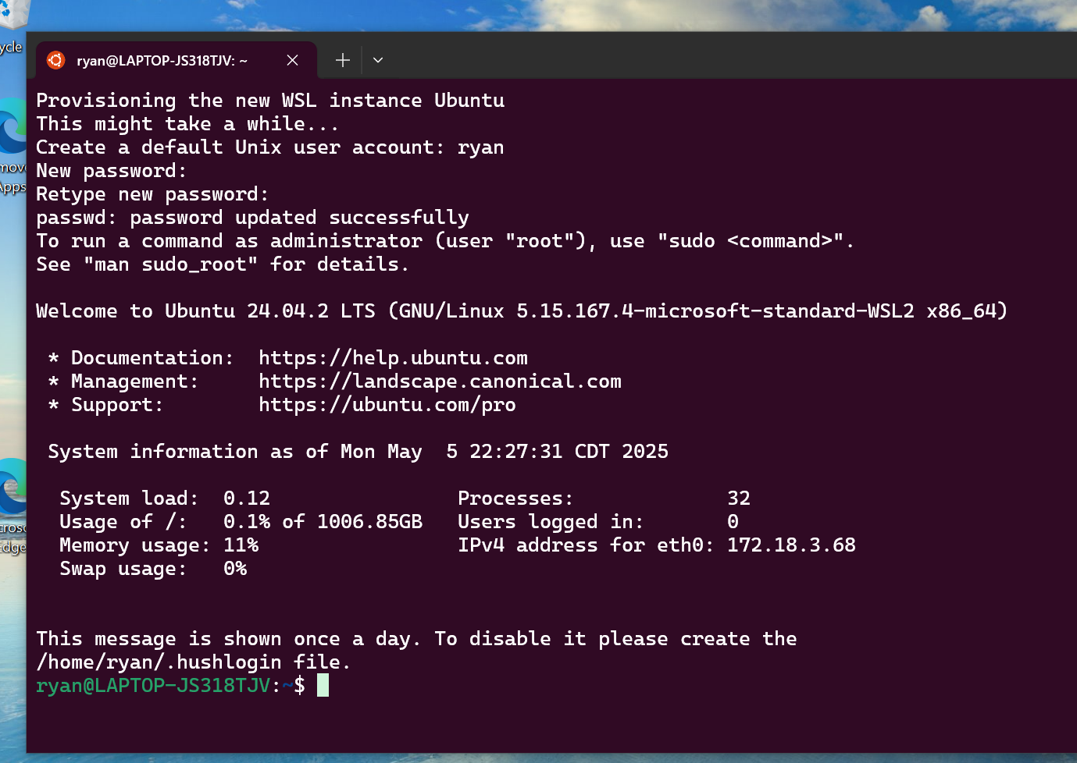
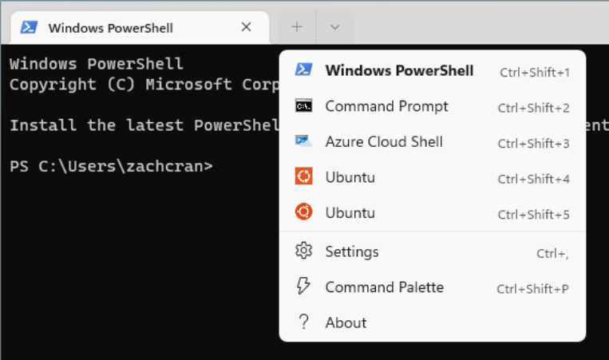
Accessing a Linux Terminal (Windows): Part 4
Open terminal.
1
Choose an “Ubuntu” tab (if you have two pick either).
2
Create a Linux profile (username and password).
3
10
11
12

Slide 14
Windows Terminal Notes
From now on “terminal” should be thought of as being synonymous with “open an Ubuntu tab in Windows Terminal”.
Linux profile need not be same as Windows profile.
Security wise makes little difference. Someone logged in with your Windows profile can get into your Linux profile (and vice versa).
Best practice: make sure password(s) is/are strong.
Don’t access Windows files (C:\Users\...) from Linux, nor Linux files (/home/…) from Windows.
Think of them as separate file systems (e.g., like one lives on a USB).
Windows and Linux use different file conventions, unless you know what you’re doing you can easily corrupt files.

Slide 15
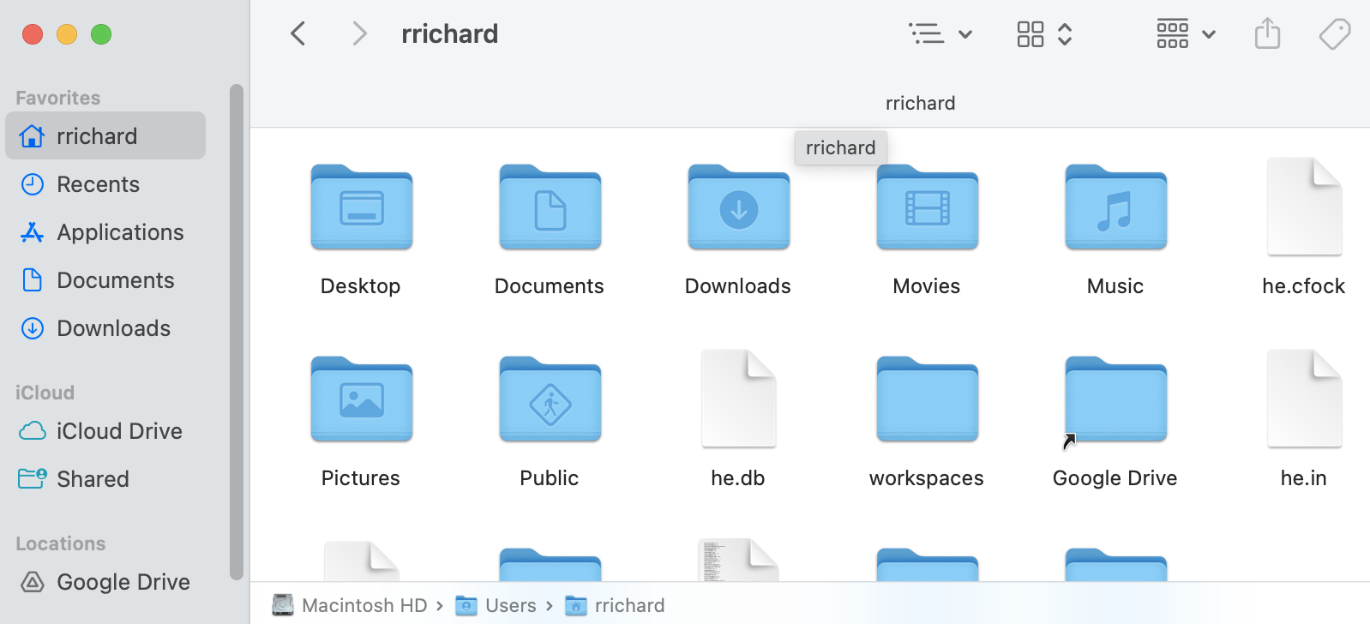
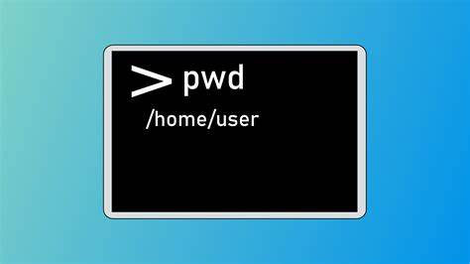
I Have a (Linux) Terminal. Now What?
Start by thinking of your terminal like a file system.
When you start terminal, you are in a folder/directory, but which one?
Type pwd (and hit enter)
The result is your current directory.
pwd stands for:
Print (write to the terminal)
Working Directory (the directory you are currently working in).

Slide 16
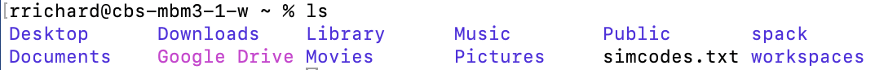
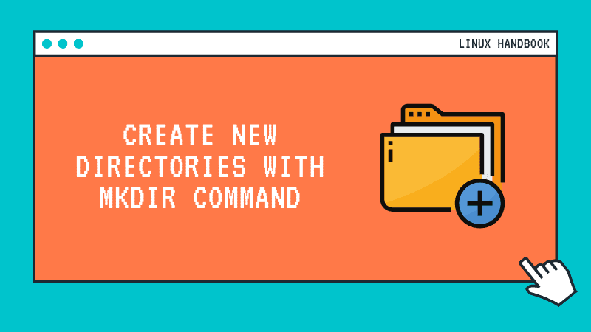
Other Filesystem Commands
ls is used to see the files and directories in your current working directory.
ls is short for list (not sure why we needed to abbreviate it…)
You may not get color (if you do, the colors denote file types)
mkdir <dirname> is used to create directories
mkdir is short for make directory.
<dirname> should be replaced with what you want to call the directory.

Slide 17
Pop Quiz: Where’s My Directory?
When I run mkdir nothing happens. How can I check if mkdir did its job?

Slide 18
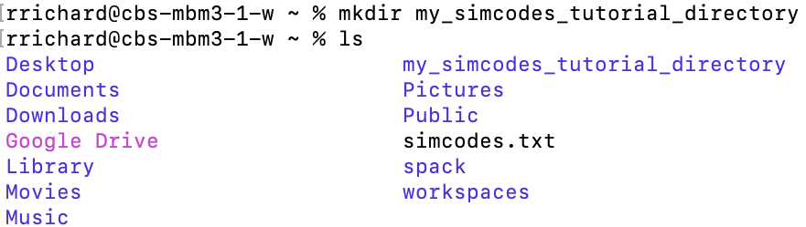
Pop Quiz: Answer
ls

Slide 19
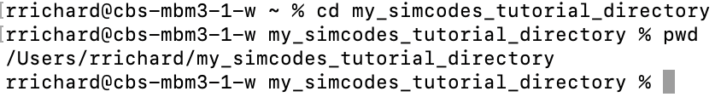
Even More Filesystem Commands
To change directory use cd.
Pro tip: “tab” key is auto-completes file/directory names. If you start typing the name of a long directory, like “my_simcodes_tutorial_directory”, try hitting tab after a few letters to let the terminal fill in the rest.
Auto-complete will only fill in as much as it can unambiguously. If it only gives you part of the name hit tab a second time to see the choices.

Slide 20
Notes on File Names
Whoever created the terminal made a terrible decision, spaces are used to separate arguments to commands.
E.g., cd my_simcodes_tutorial_directory the command (cd) is separated from the argument (my_simcodes_tutorial_directory) by a space.
If your file/directory names contain spaces, we now run into a problem
TL;DR get in the habit NOW of avoiding spaces or special characters (&*$#!) in file/directory names. For our purposes “-” and “_” are NOT special characters.

Slide 21
Command Summary
pwd prints the working directory.
ls shows the files and directories in a directory.
mkdir creates a directory.
cd changes the directory.
There are a ton more https://www.geeksforgeeks.org/linux-commands-cheat-sheet/

Slide 22

Objectives
Know what a Linux terminal is.
Know how to access a Linux terminal.
Know the most important Linux terminal commands.
Install Python.
Write a “Hello World” Python module.
Run the “Hello World” Python module.

Slide 23
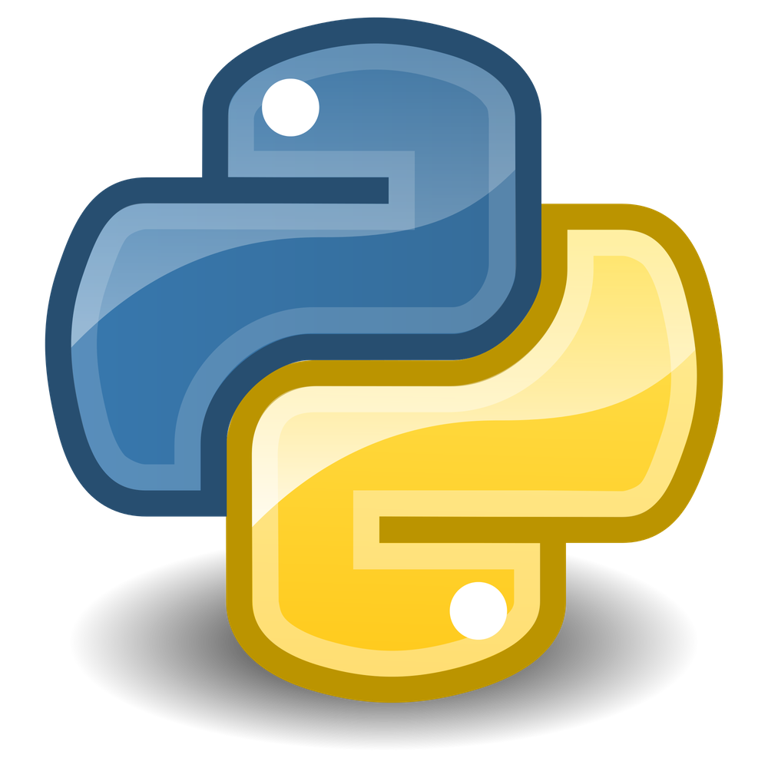

What is Python?
Named for Monty Python
GeeksForGeeks: Most popular programming language.
Design philosophy prioritizes code readability.
“High-level” language.
Python programs are relatively performant without exposing “low-level” details like memory management.
“Natural language”-like syntax
Becoming the de facto language of scientific computing.
Notable exception is high-performance computing where C++ still dominates, but Python is gaining.

Slide 24
Installing Python (MacOS)
You’re done.

Slide 25
Installing Python (Windows)
You’re also done.

Slide 26

What is a Python Module?
It is a text file that contains Python source code.
Caveat: Need to be plain text files, e.g., NOT Word documents.
Named like name_of_file.py (“.py” is standard extension).
The Python “interpreter” is responsible for running the module.
python (or sometimes python3) .
To run a Python module you simply tell the interpreter the name of the module
E.g., python name_of_file.py

Slide 27
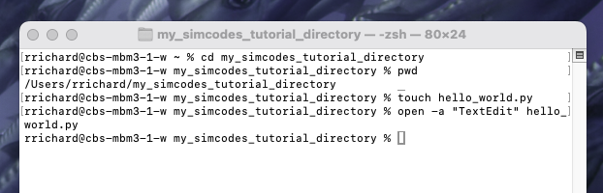
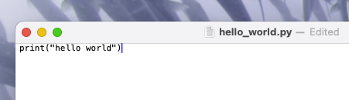
Creating a Python Module (MacOS)
Open terminal.
touch hello_world.py
touch makes an empty file (if it doesn’t exist) and updates its timestamp to now.
open –a “TextEdit” hello_world.py
If the file doesn’t exist, this command will complain.
Type print(‘hello world’), then ⌘ + s (saves).
Wait for your Windows colleagues (again).

Slide 28
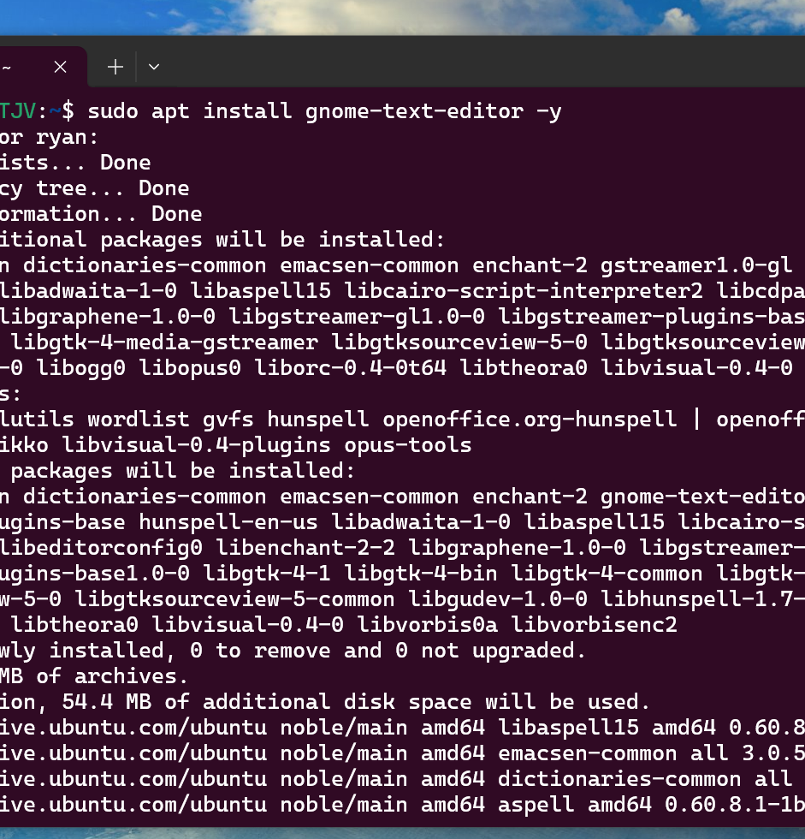
Creating a Python Module (Windows): Part 1
Open a terminal.
sudo apt install gnome-text-editor –y
sudo stands for super user do (Linux equivalent of administrator).
apt stands for Advanced Package Tool (Linux equivalent of Microsoft Store).
install gnome-text-editor (installs Gnome’s text editor)
–y Answers “yes” to all questions (like “are you sure”).

Slide 29
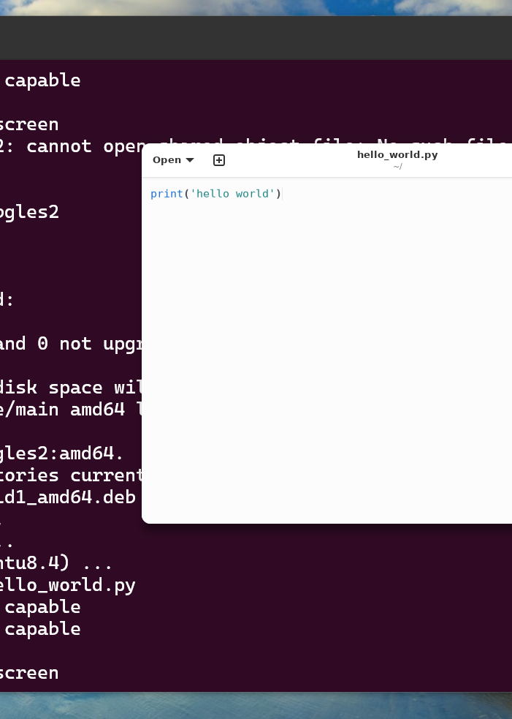
Creating a Python Module (Windows): Part 2
gnome-text-editor hello_world.py
(Do not have to create file ahead of time).
If this fails, Gnome Text Editor may be missing a file.
Run sudo apt install gedit -y
Try the command again.
Type print(‘hello world’), then ctrl + s (saves).

Slide 30
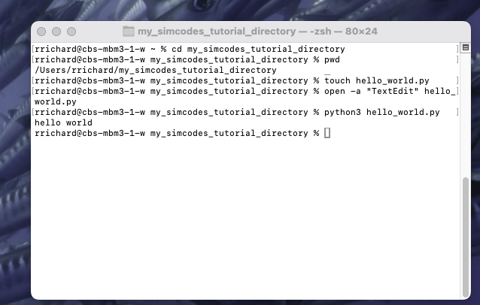
Running Our Python Module

Slide 31
Objectives
Know what a Linux terminal is.
Know how to access a Linux terminal.
Know the most important Linux terminal commands.
Install Python.
Write a “Hello World” Python module.
Run the “Hello World” Python module.

Slide 32

Software Development Environment (SDE)?
The title was “Setting Up A Software Development Environment” and we haven’t mentioned SDE yet…
An SDE is just a collection of tools to develop, test, and debug an application.
Terminal is arguably the most important tool for development.
Python comes with tools for testing and debugging. We’ll go over those tools in future lectures.
TL;DR you now have a bare-bones SDE!!!

Slide 33

Acknowledgements
MolSSI. I “borrowed” (i.e., stole) the content from them.
Installing terminal: https://education.molssi.org/python-package-best-practices/setup.html
Terminal: https://github.com/msse-chem-280-2024/msse-chem-280-2024.github.io/
NSF for funding SIMCODES

